Slide 1
ASSIGNMENT 7:
Module 16: Building Database Apps with PostgreSQL & Python
Description: For this assignment, you are required to:
Complete all course lectures within the module, ensuring you follow the concepts taught in each session.
Implement all practical exercises provided in the course lectures. Each practical task should be executed and the results properly documented.
Take complete, unedited screenshots of each practical output along with the corresponding code. Ensure that the following are visible in your screenshots:
The full code you executed.
The output displayed on your system, including the system timestamp.
No cropping or editing should be done on the screenshots. Any attempt to crop or modify the screenshots will result in your submission being considered invalid, and you will be required to resubmit it.
Submission: You should either:
Zip the folder containing all your practical screenshots, or
Prepare a PDF containing all the screenshots and code.
Ensure the screenshots are organized clearly and in the correct order according to the sequence of lectures and practicals. Lastly, upload it to drive and then submit the accessible link (make sure to enable sharing access).

Slide 2
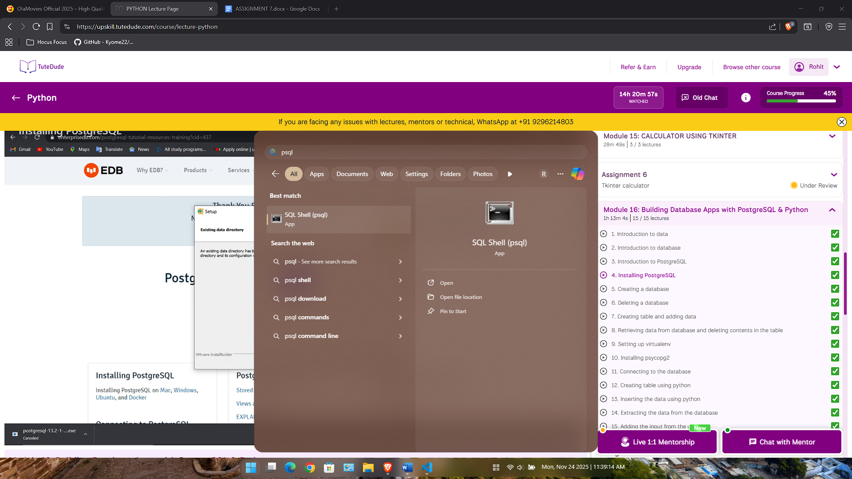
1. Installed PostgreSQL

Slide 3
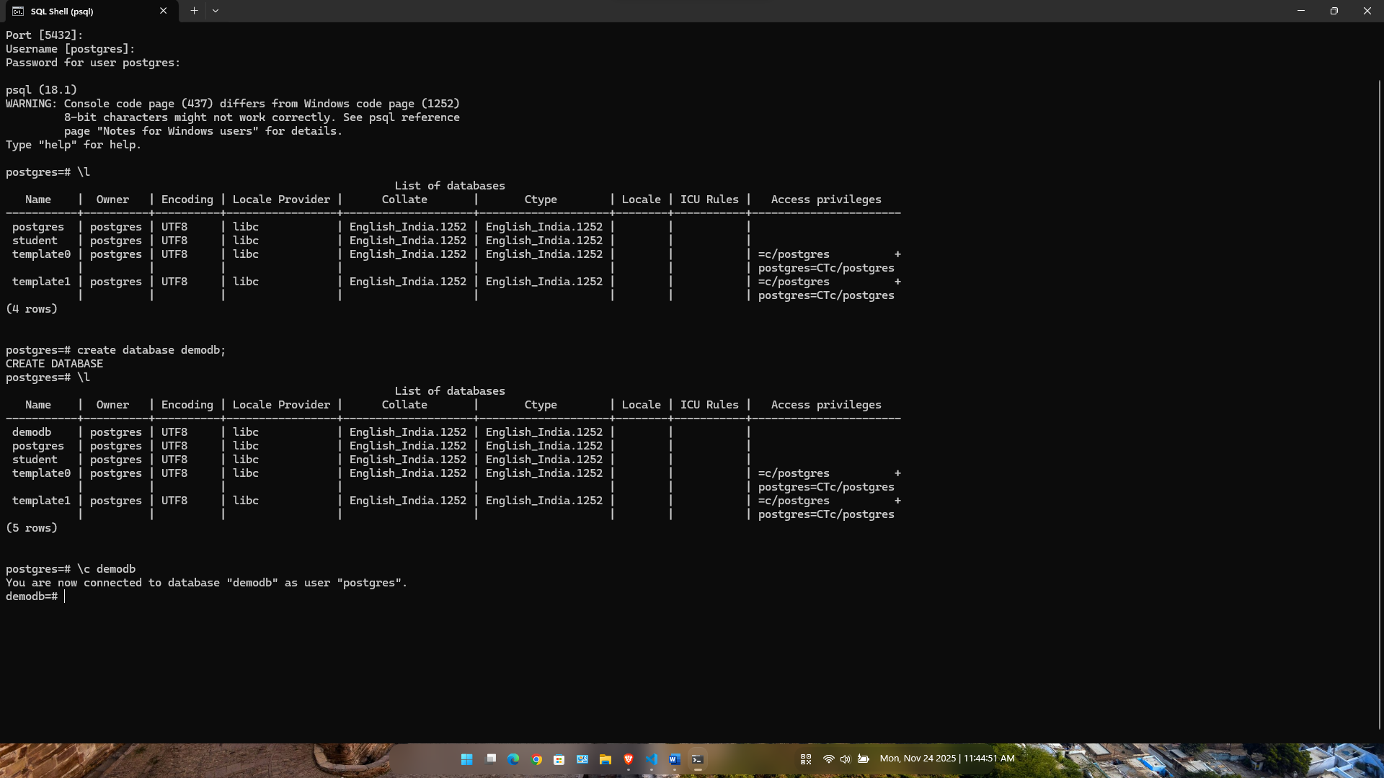
2. Creating a database

Slide 4
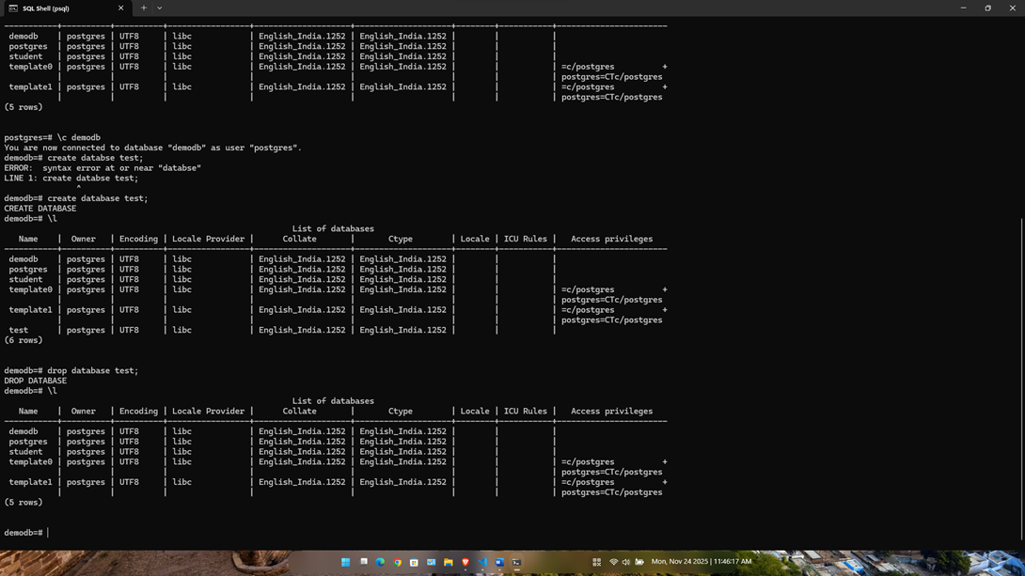
3. Deleting a database

Slide 5
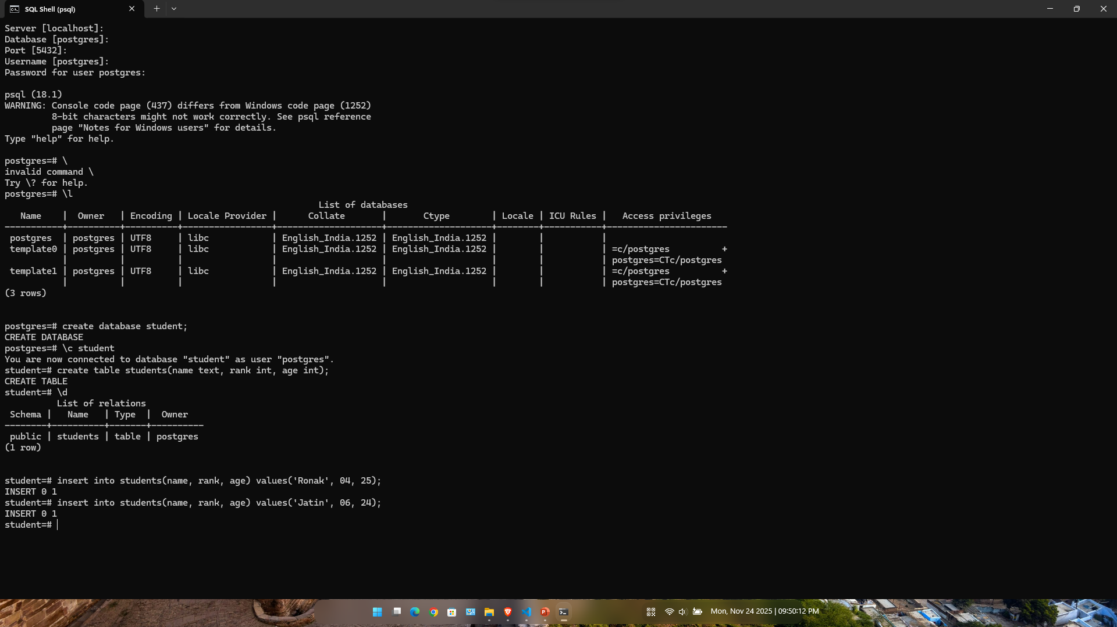
4. Creating table and adding data

Slide 6
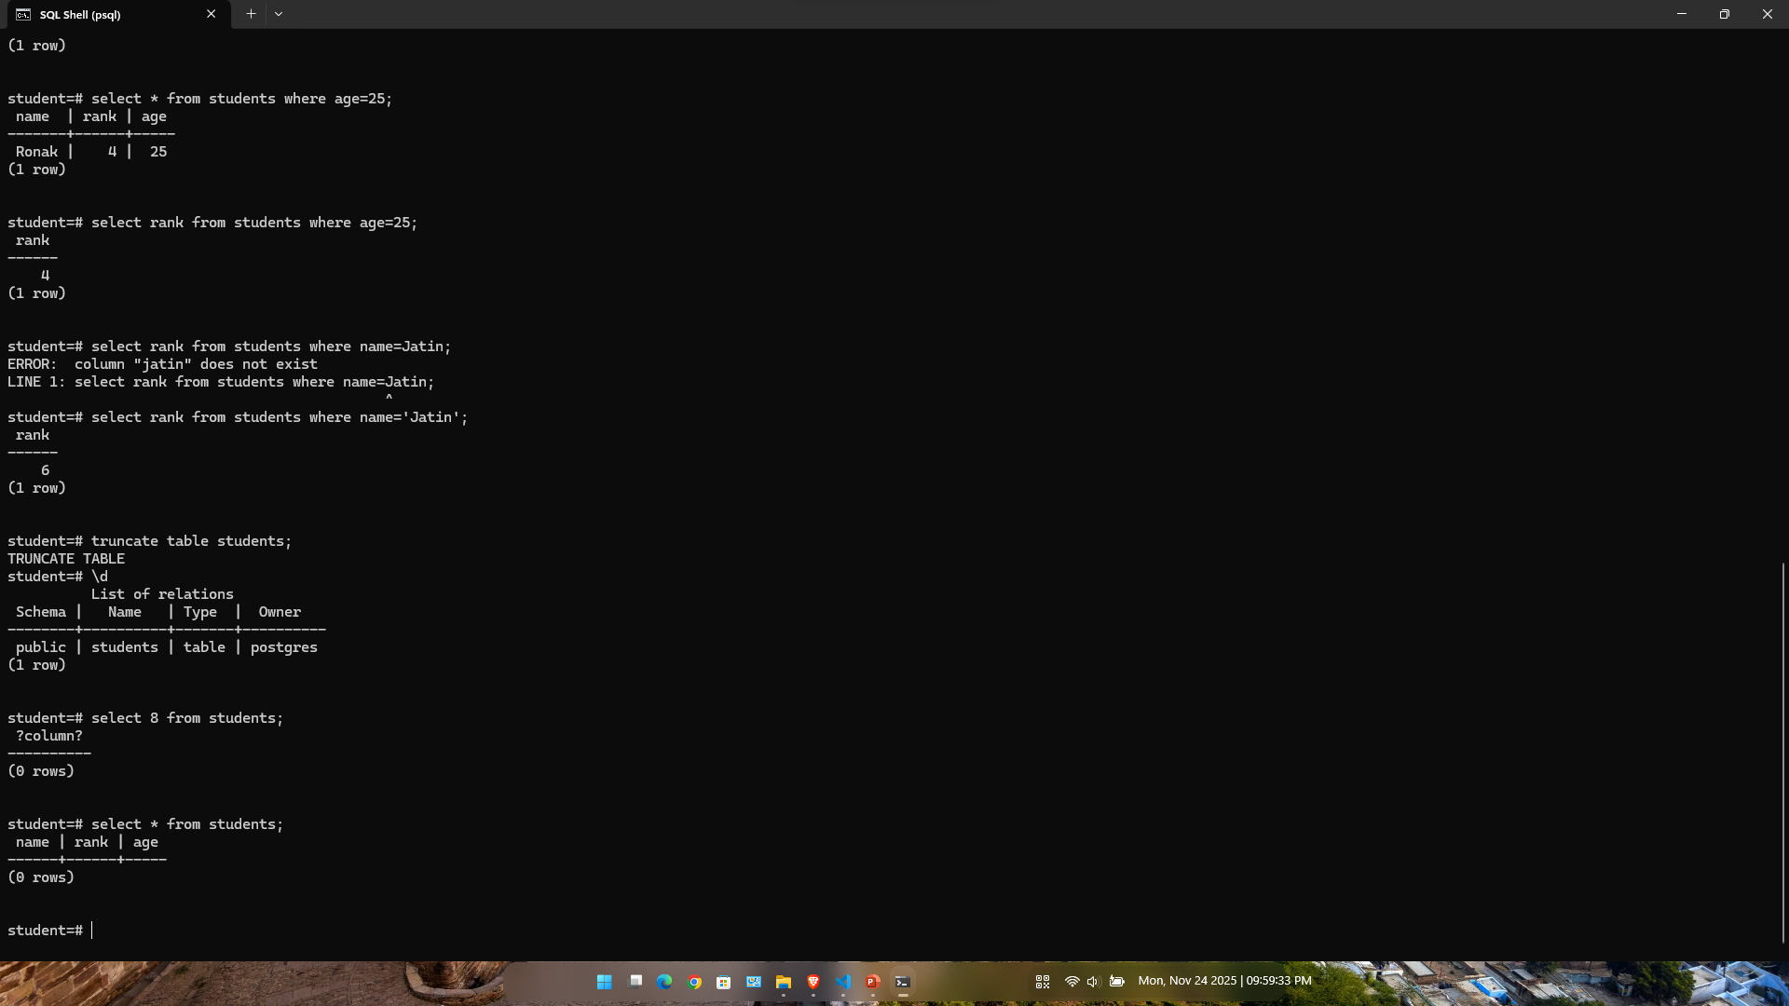
5. Retrieving data from database and deleting contents in he table

Slide 7
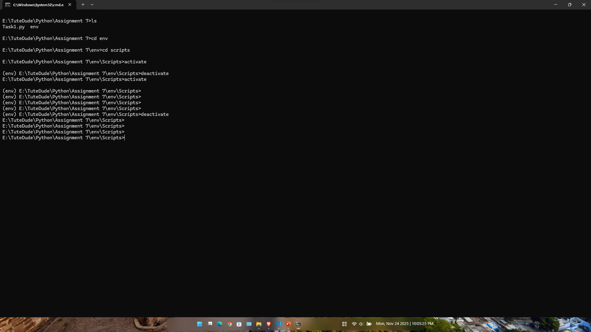
6. Virtual Environment Setup

Slide 8
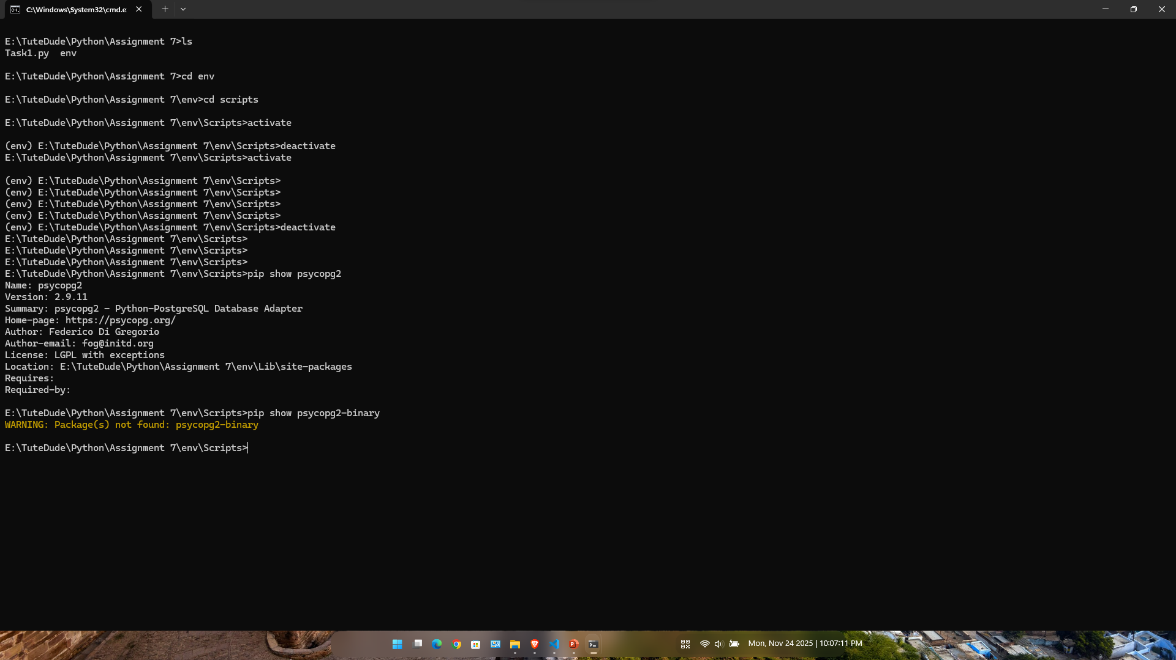
7. Installing psycopg2

Slide 9
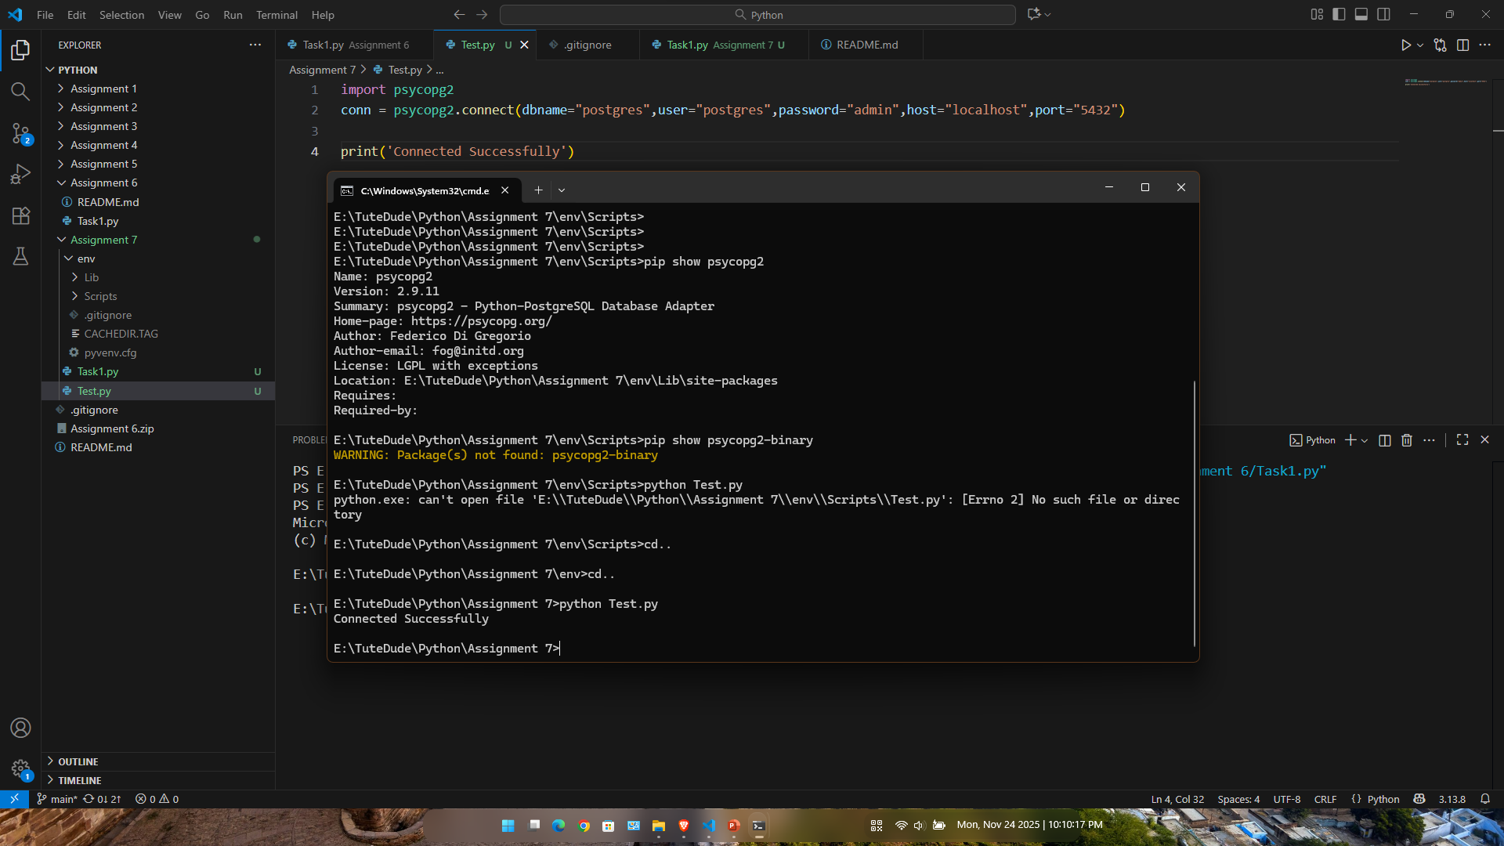
8. Connecting to database

Slide 10
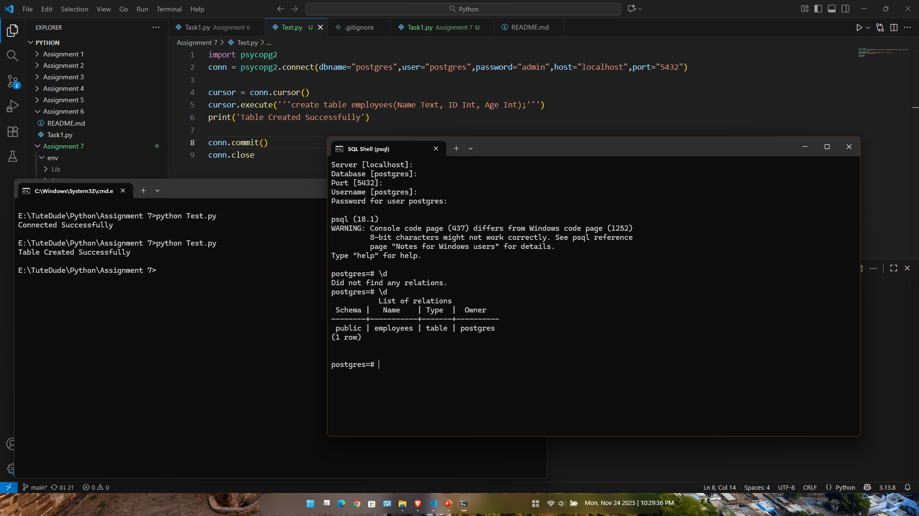
9. Creating table using Python

Slide 11
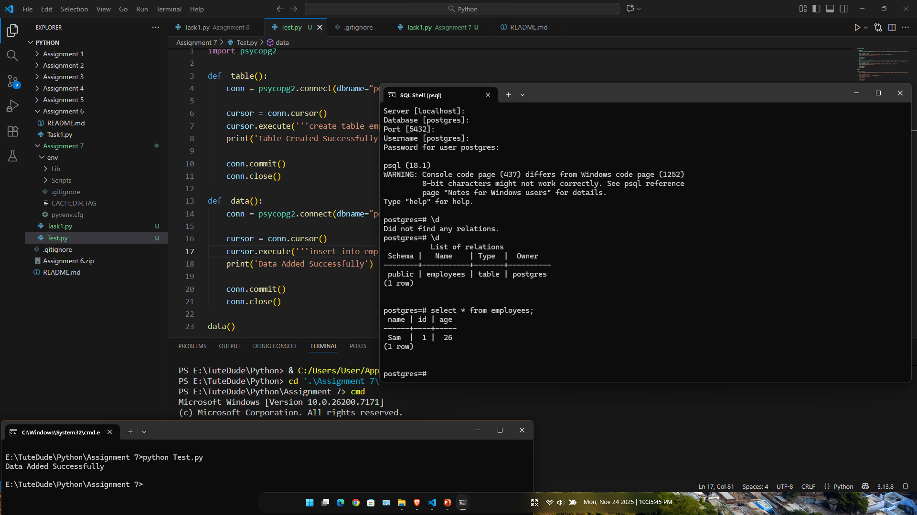
10. Inserting the data using Python

Slide 12
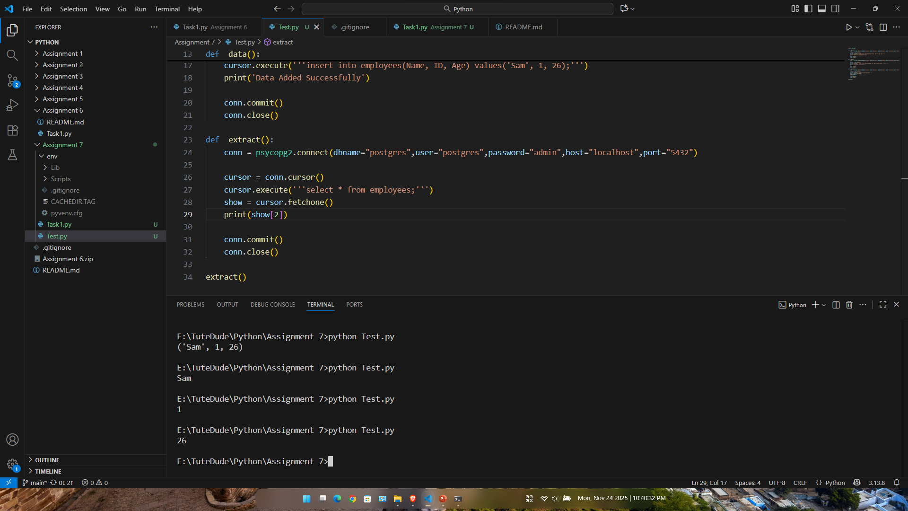
11. Extracting the data from database

Slide 13
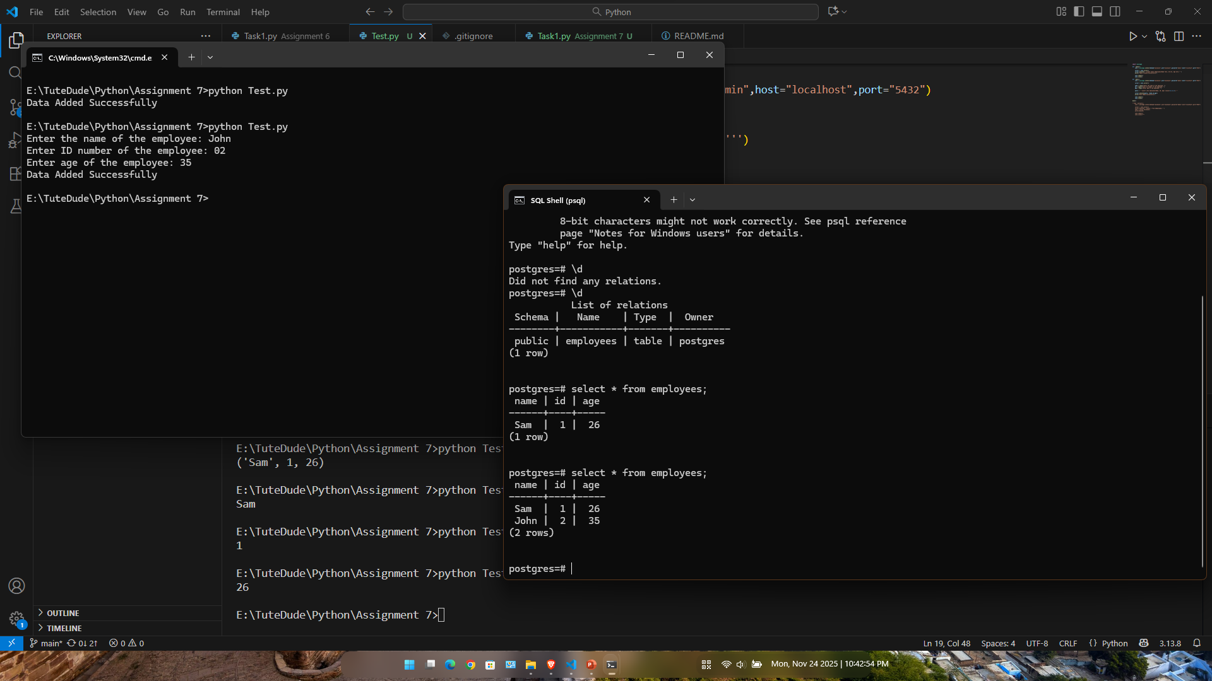
12. Adding the input from user

